Slide 1
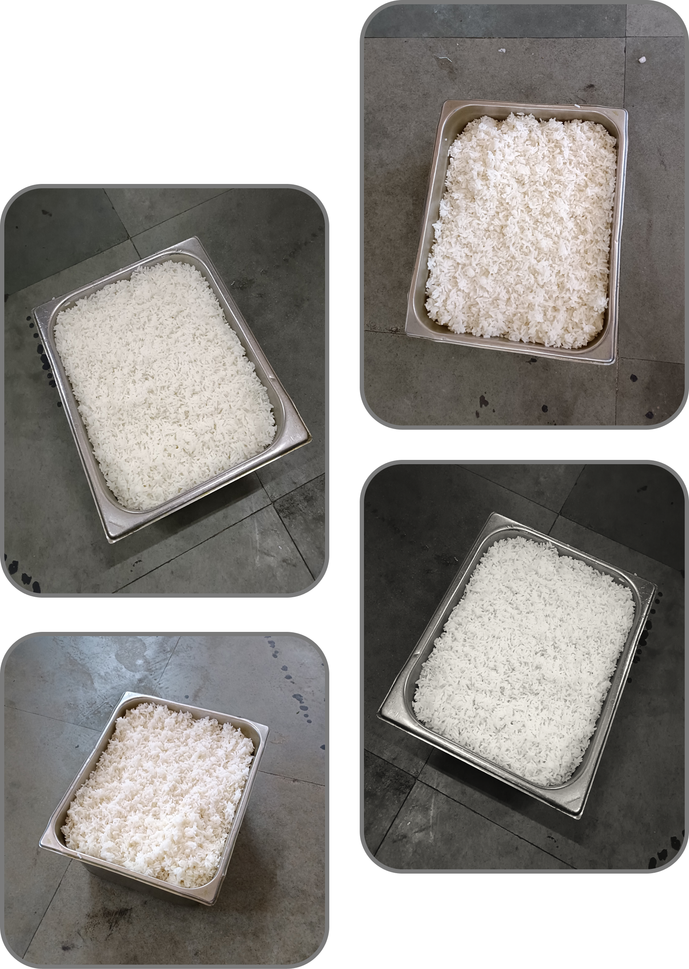


Kriti 2024
Tackling Food
Wastage

Slide 2
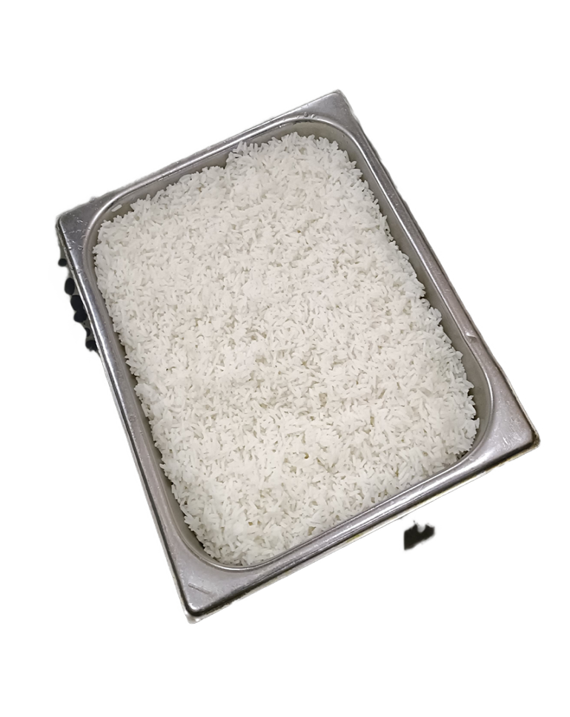
Food Wastage in Siang Hostel
Problem Statement
This case study addresses the persistent problem of excessive food wastage, with a specific emphasis on plain rice, within Siang Hostel. The primary objective is to delve into the reasons contributing to this wastage and, more importantly, to propose effective solutions aimed at minimizing both environmental and economic waste.
Mission
Vision
To revolutionize mess operations by implementing sustainable practices, reducing food wastage, and enhancing the dining experience for hostel residents
Create a mess environment where every grain matters, aligning with our commitment to sustainability and the well-being of our hostel community.
Goals
Wastage Reduction: Minimize food wastage through a tailored solution.
Nutritional Excellence: Ensure our solution meets hostel residents’ nutritional requirements.
Operational Efficiency: Optimize food planning, consumption, and disposal for a more sustainable mess operation.
Stakeholder Engagement: Address concerns and feedback from students, mess committee members, and employees.

Slide 3

Factors Contributing to Wastage
Overestimation of Demand
Irregular Attendance
The kitchen staff tends to overestimate the quantity of rice needed, leading to excess preparation.
Some residents may have irregular eating habits or might not participate in hostel meals consistently.
Overestimation contributes to 40% of rice wastage.
Irregular attendance contributes to 30% of rice wastage.
Lifestyle and Eating Habits
Inefficient Portion Control
The eating habits and preferences of residents play a significant role in the surplus of plain rice.
Poor portion control during food distribution can leave portions of rice unserved.
Economic Impact
The combined economic impact of overestimation and irregular attendance results in an estimated wastage of Rs. 4000 per month.

Slide 4

Solutions:
Real-Time Monitoring
Demand Forecasting:
Flexible Production
Implement real-time monitoring of rice consumption.
Utilize historical data and meal attendance records.
Adjust rice preparation based on real-time demand.
Enhance efficiency and reduce wastage through responsive production.
Consider variables such as day of the week and special events for accurate predictions.
Cook smaller, manageable quantities during meal service.
Inventoy Management
Additional Innovations
Maintain optimal rice stock levels.
Mobile App Integration:
Reuse Strategy:
Adopt JIT approach for efficient stock replenishment.
Launch a user-friendly app for real-time updates, meal planning, and attendance tracking.
Integrate a sustainable approach by reusing lunch rice at live counter at a discounted rate (60%).
Enable students to pre-select their meals, providing valuable data for demand forecasting.

Slide 5

Model Selection for Inventory Optimization
Rationale:
JIT is chosen for its focus on real-time production, aligning perfectly with the dynamic challenges of rice wastage in the hostel mess.
Implementation of JIT Model:
Variables Input and Output Explanation:
Real-Time Attendance Tracking: Utilizing attendance data to dynamically adjust production quantities.
Input Variables:
Real-Time Attendance Data
Historical Consumption Analysis: Examining past consumption patterns for informed decision-making.
Historical Consumption Patterns
Meal Preferences
Timely Production Schedule: Implementing a production schedule aligned with meal times and confirmed attendance.
Output Obtained:
Optimal Production Quantities
Timely Production Schedule
Supplier Collaboration: Establishing effective collaboration with suppliers to ensure fresh ingredient delivery aligns with production needs.
Reduced Inventory Levels
Cost Savings

Slide 6


Alignment, Evaluation, and Potential Impact
Alignment with Challenges of Rice Wastage:
Irregular Attendance:
JIT addresses irregular attendance by producing meals based on real-time data, preventing excess production.
Overestimation of Demand:
Real-time data utilization minimizes the risk of overestimating demand, reducing the likelihood of rice wastage.
Lifestyle and Eating Habits:
Historical consumption patterns help align food production with residents' habits.
Evaluation of suitability:
Potential Impact on Reducing Food wastage:
Adaptability:
Optimized Production:
JIT's adaptability to real-time data and dynamic attendance patterns suits the unpredictable nature of hostel meals.
JIT has the potential to significantly reduce rice wastage by ensuring meals are produced in optimal quantities and precisely when needed.
Cost-Effectiveness:
By producing meals only when needed, JIT contributes to cost savings, making it suitable for the hostel mess.

Slide 7




Understanding Food Preferences
40%
30%
25%
Lunch
Dinner
Special Dinner
40% rice, 60% roti
30% rice, 70% roti
25% rice, 75% veg pulao
Note: This data is came from google form submitted by mess subscribers

Slide 8
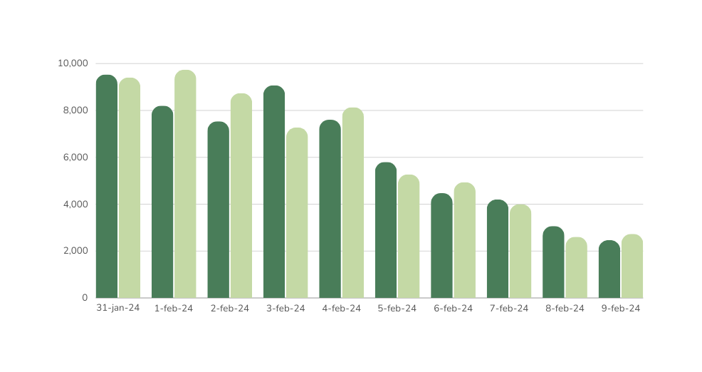
QUANTIFYING WASTAGE
Lunch
Dinner
Volume (cubic cm)
Date

Slide 9
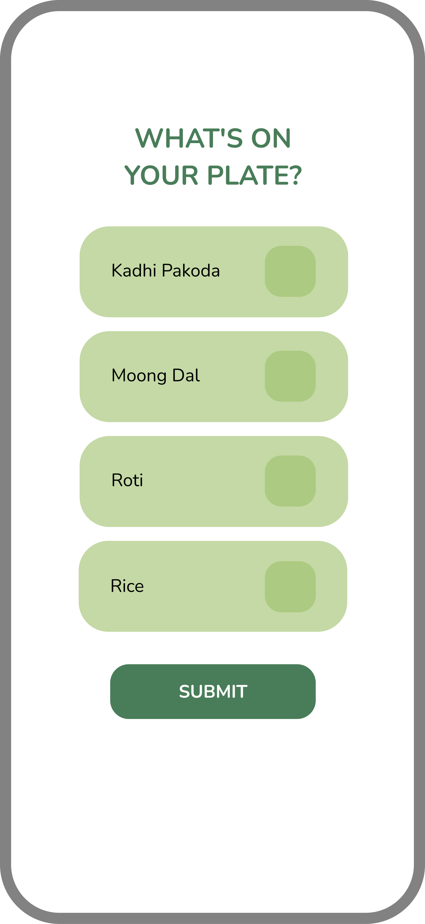
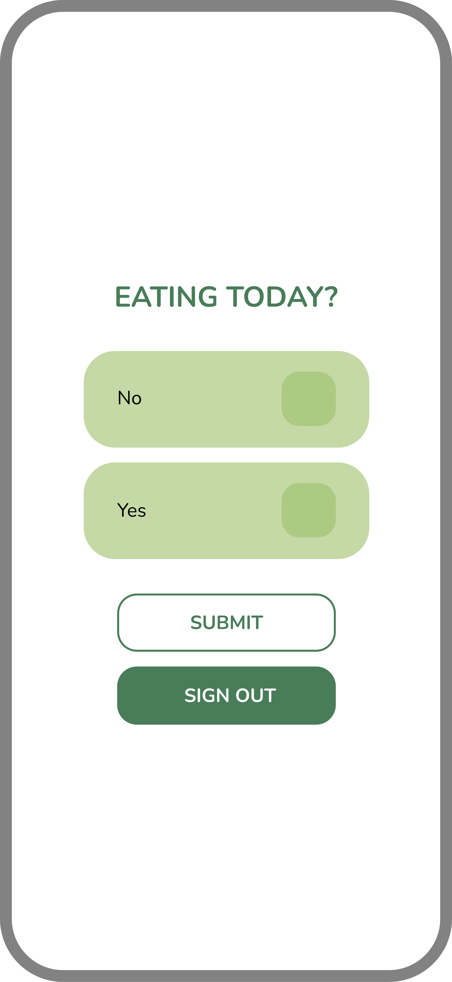
Proposed Solution: Introduction of App
1
Daily Attendance Confirmation
2
Menu Display
If the user confirms attendance, show today's menu and inquire about their food preferences, specifically rice or roti (or any other options).
Enable users to provide daily responses on whether they are coming for lunch/dinner.
3
Feedback Section
4
Attendance Verification
Include a feedback section for users (hostelers) to express their opinions on the solution's feasibility or any other relevant feedback.
Implement a QR code scanning system to verify whether the user has physically attended the meal session.

Slide 10



Implementation Plan for the App in Siang Hostel
1
Training and Integration
Conduct app training sessions for kitchen staff and integrate system with existing processes.
2
Testing and Feedback
Thoroughly test the app's functionality and gather feedback from residents for further improvements.
3
Launch and Promotion
Officially launch the app and promote its benefits to encourage adoption among residents.

Slide 11
Feasibility Of Solution
Implementation Ease
Cost-Effectiveness
Criteria: Assessing the ease of integrating the proposed solution.
Criteria: Analyzing the financial implications of the proposed solution.
Considerations: User-Friendly Interface, Training Requirements, Technical Support Availability
Considerations: Initial Setup Costs, Maintenance Expenses, Potential Savings
Positive Aspect: Enhanced user experience with a seamless and intuitive interface contributes to smoother implementation.
Positive Aspect: Cost savings for the mess through efficient resource use, including a 60% discounted price for reused dishes.
Stakeholder Acceptance
Overall Viability
Criteria: Ensuring buy-in from key stakeholders.
Criteria: Evaluating the holistic feasibility of the proposed solution.
Considerations: Student Satisfaction, Mess Committee Approval, Employee Cooperation
Considerations: Alignment with Mess Operations, Long-Term Sustainability, Adaptability to Changing Conditions
Positive Aspect: Alignment with sustainability goals and fair pricing contribute to higher stakeholder acceptance.
Positive Aspect: Reduction in overall food wastage aligns with sustainability goals and supports long-term viability.

Slide 12

Voices Heard, Concerns Addressed
Student Satisfaction:
App helps me plan meals better!
Discounted prices encourage sustainability.
Reduced wastage noticed; appreciate the effort!
Mess Committee Approval:
Positive impact on operations efficiency.
Consistent quality ensures overall satisfaction.
Challenges addressed effectively.
Employee Perspectives :
Streamlined processes save time and effort.
App usage simplifies attendance tracking.
Cost savings observed in the kitchen.

Slide 13



Conclusion & Next Steps
Evaluation of Proposed Solutions
Implementation Roll-out
Continuous Monitoring
Planning and executing the integration of the chosen solution into regular mess operations.
Establishing a monitoring system to track and analyze the effectiveness of the implemented solution.
Assessing feedback and data to confirm the feasibility and potential impact.
The Road Ahead:
Envisioning a mess operation that minimizes waste and maximizes efficiency.
Fostering a culture of sustainability and responsibility.
Continued collaboration with stakeholders for evolving solutions.

Slide 14

REFERENCES
Food Preferences Data (App)
https://drive.google.com/drive/folders/1J5BUG0K1dyKh9VIqbkFckco-B0ssA3L6
Wastage Report
https://1drv.ms/x/c/3ca247d1f32f674c/EVLOD15XYFxJpYNccyuSF4UBrzYYJxMzPsASr2aodu9cyg?e=T1FC8B
Rice Wastage Photos
https://drive.google.com/drive/folders/1H8fiqz-NxlcSUhoP2Xesnm_ztlvTB671
Food Preferences Data (google form)
https://docs.google.com/spreadsheets/d/17G8vqB2CXKwzXYWYtyihVt_pPcr7BORXQTLFuy_fvfE/edit?usp=drivesdk

Slide 15

Our Team
Sanchay Baranwal
Shivam Savani
Ansh Pal
Kartik Gupta
Ojas Thete
Pranav Deshmukh

